Slide 1
REFORMING DOCTORAL STUDIES IN MONTENEGRO AND ALBANIA
GOOD PRACTICE PARADIGM
REPORT of FIRST YEAR ACTIVITIES
UMT
TIRANA, ALBANIA
MARDS VIENNA MEETING
Betim Cico
bcico@gmail.com
Date: 11. 12.2019 – 12.12.2019
Place: Vienna, Austria

Slide 2

ACTIVITIES OF UMT
Participation in:
1. Kick of Meeting - Podgorica, Montenegro
Participants from UMT:
Arjan Cuka - administrator of UMT
      Prof. Betim Cico
Erida Elmazi
Kotor Meeting (29 Prill 2019),Montenegro. Participants from UMT:
Prof. Betim Cico
Contribution: 2 fullfiled questionnaire for 2 reports
During the period of March - April

Slide 3
ACTIVITIES OF UMT
Report on the State-of-art in Doctoral Education in Montenegro and Albania and Comparison with EU Practices.
Report on Funding the Doctoral studies in Montenegro and Albania.
Preparing comments about the reports.
Active discution in Kotor meeting for both reports.
Presentation about both problems related with Albania

Slide 4
Staff Training for PhD studies
1. MARDS Training in Vienna on „Professional Management of Doctoral Studies“ from 25 – 28 June 2019.
Participants from UMT:
1. Prof. Niko Civici zv. Rektor of UMT
( for health reason did not partipate)
2. Ornela Lina.
2. MARDS Workshop in Dubrovnik (on Professionalization of Ph.D. supervision.
Participants from UMT:
1. Dr. Elton Domnori,
2. Dritan Osman(5-6 September 2019) ( for health reason did not partipate)
.

Slide 5
Staff Training for PhD studies
3. The 3rd MARDS Training of academic and professional staff on EU practices of doctoral education: Collaborative Doctoral Programmes” take place in Banska Bystrica, Slovakia, from 2 – 5 October 2019).
Participants from UMT:
1. Prof. Niko Civici zv. Rektor of UMT
2. Prof. Betim Cico
4. The 4th MARDS Training of academic and professional staff on “Quality Assurance of Doctoral Studies”, Maribor, Slovenia, from 7 – 8 November 2019).

Slide 6
Staff Training for PhD studies
Participants from UMT:
1. Prof. Betim Cico,
2. Prof. Niko Civici vice rector,
3. Emre Cecen
Conclusion:
All staff training and workshops were organized in very good way.
Are very fruitful and fulfil all the request of our staff members.
During January and February 2019 UMT is going to organize some workshops in UMT based on staff training workshops in frame of project.

Slide 7
Other Activities
Preparation part of Curricula and 4 syllabuses for IT based courses
Period: September – November
Working group:
Prof. Betim Cico
Prof Ozcan Asilkan
Dr. Elton Domnori.
The draft idea was prepared for the presantation in the 3rd MARDS Training of academic and professional staff on “EU practices of doctoral education: Collaborative Doctoral Programmes” take place in Banska Bystrica, Slovakia, from 2 – 5 October 2019).

Slide 8
Report on Videoconference systems
UMT :
Period : June - September
updated list of equipments together with coordinator of the project and aprovement from Bruksell.
September – November.
All the procedures for videoconference system. System is ready in Metropolitan University to be installed.
For the first-year one-page report for equipent in Albanian universities are missing half page information from UNISH, PUT and UV.

Slide 9
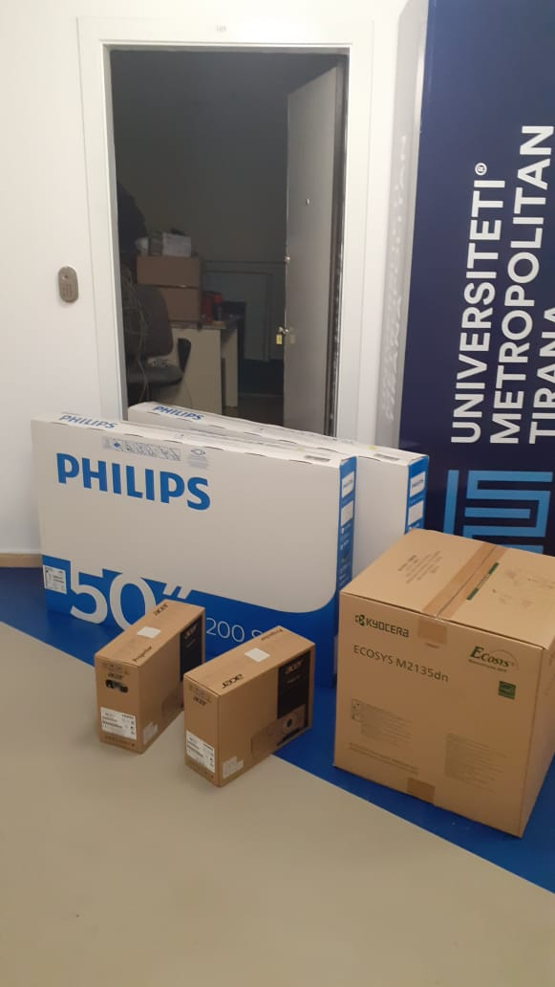
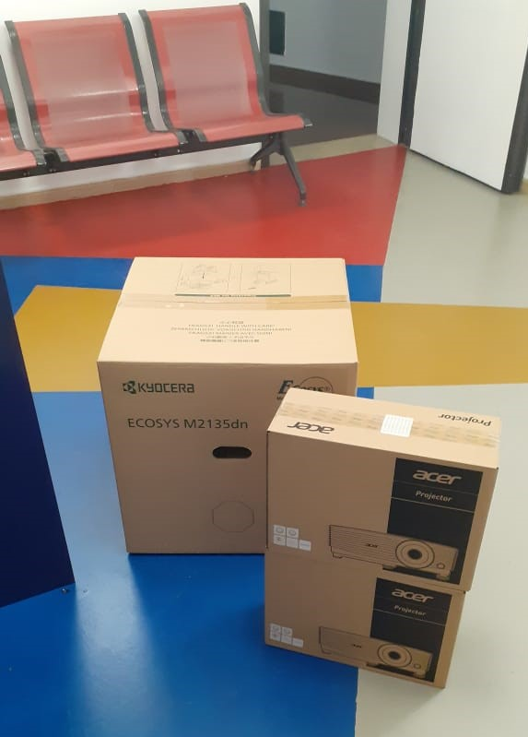
Report on Videoconference systems
UMT :

Slide 10
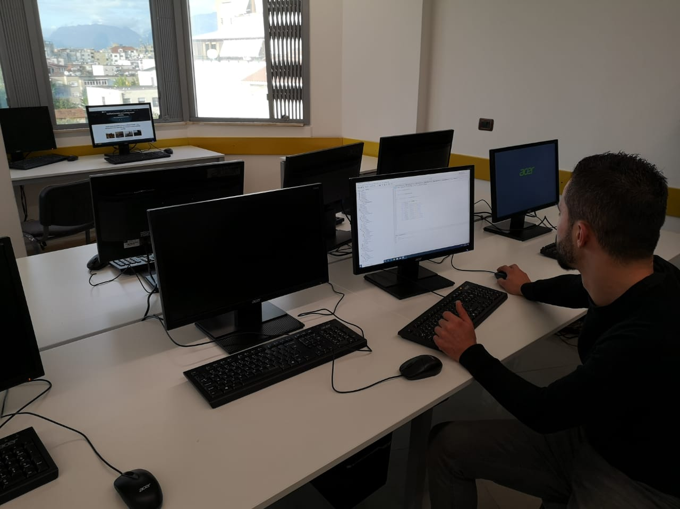
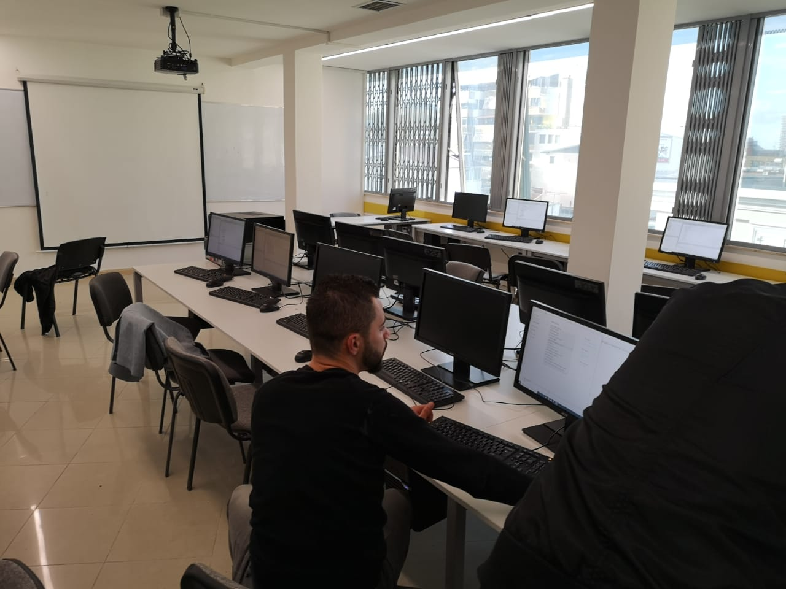
Report on Videoconference systems
UMT :

Slide 11
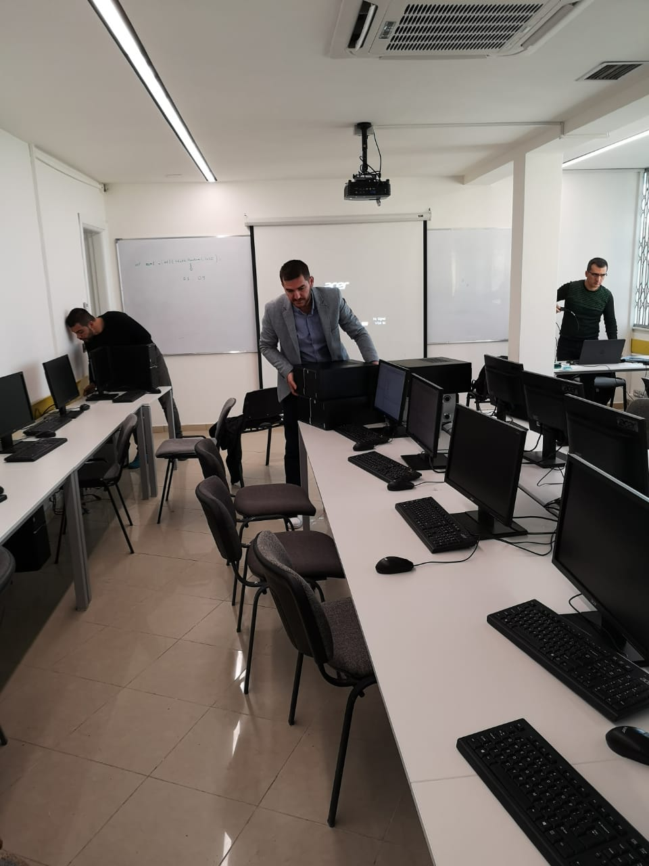
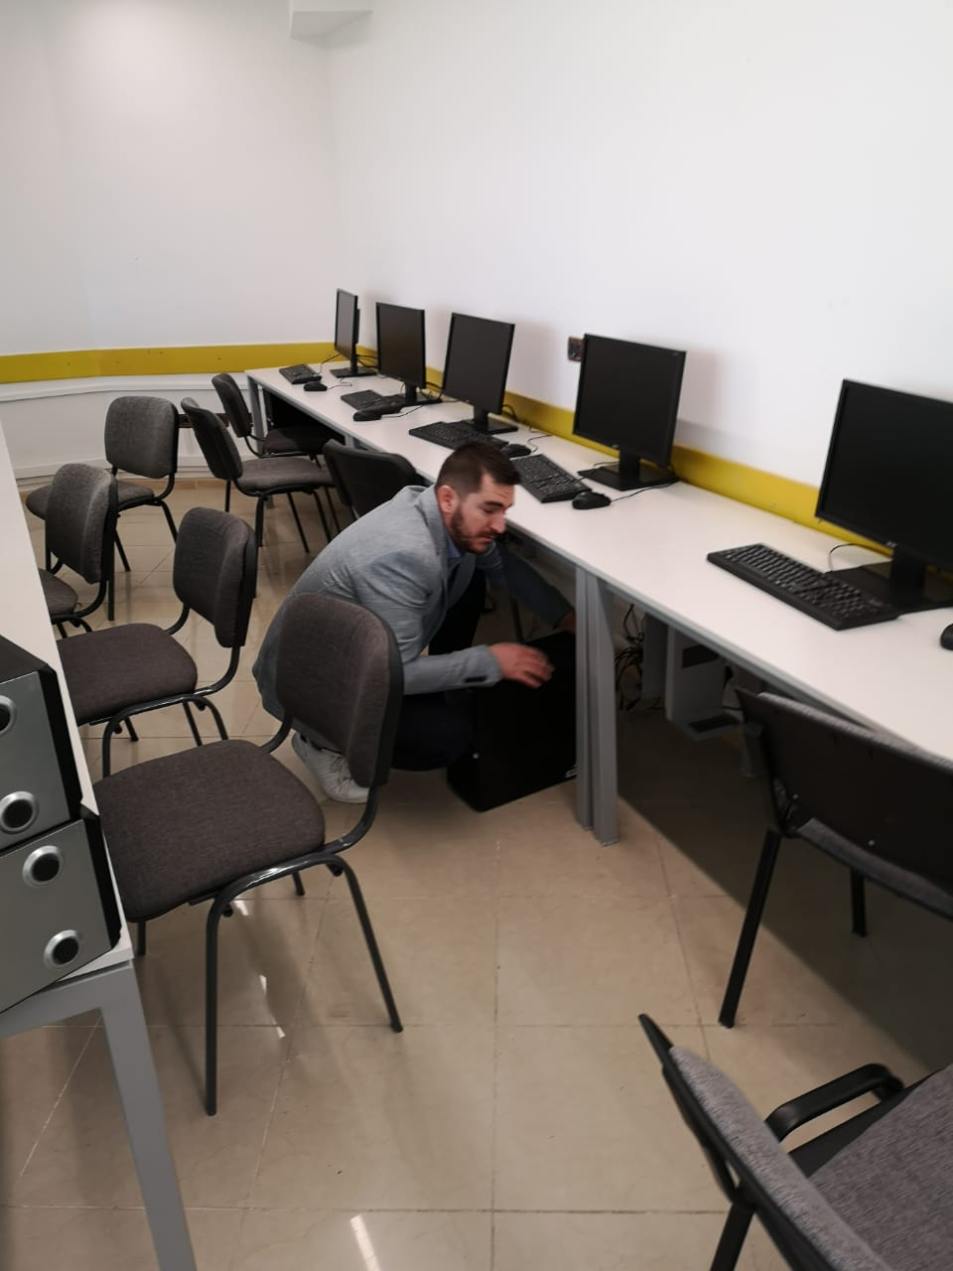
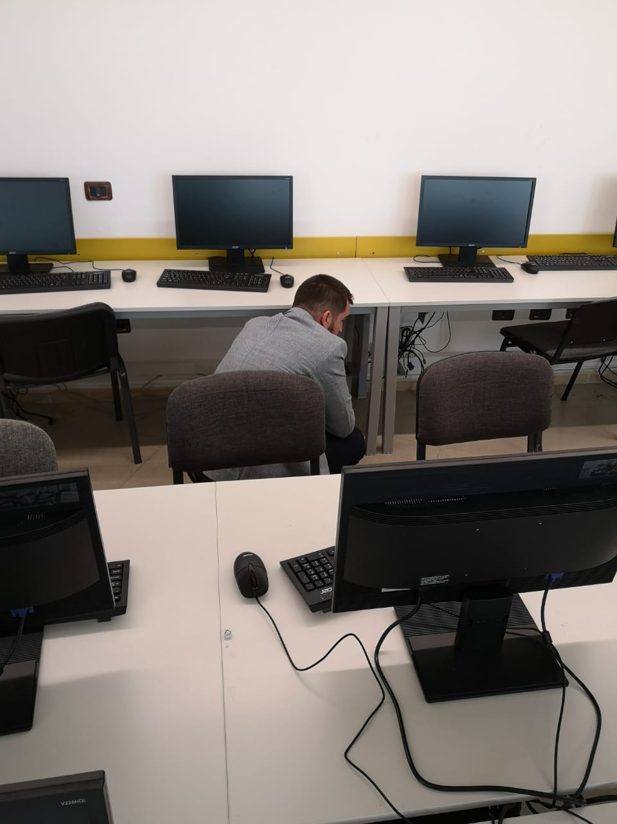
Report on Videoconference systems
UMT :

Slide 12
Workshop in Tirana
Workshop in Tirana(September 22-23) , hosted by UMT
Participants : around 20 persons from all 6 Albanian partners and 2 from Montenegro.
From UMT participated 6 members: Arjan Cuka - Administrator of UMT, Prof. Betim Cico, Prof. Nikola Civici- Vice Rector. Prof. Ozcan Asilkan Dean, Ms. Elvis Hazizi, Finance officer of the project.
-The progress of cooperation between Albanian partners and MASR-related problems.
-During this meeting, many important issues were discussed, especially opening of doctoral studies by MASR.

Slide 13
Local event for dissemination of the project
UMT
Design and printed A4 (50 pieces) and A1(20) posters before the Kick of meeting.
February 2019 – Presentation of the project in front of the staff and students
Postpone the 30 minutes program in ART.
It was plan for December 3.

Slide 14
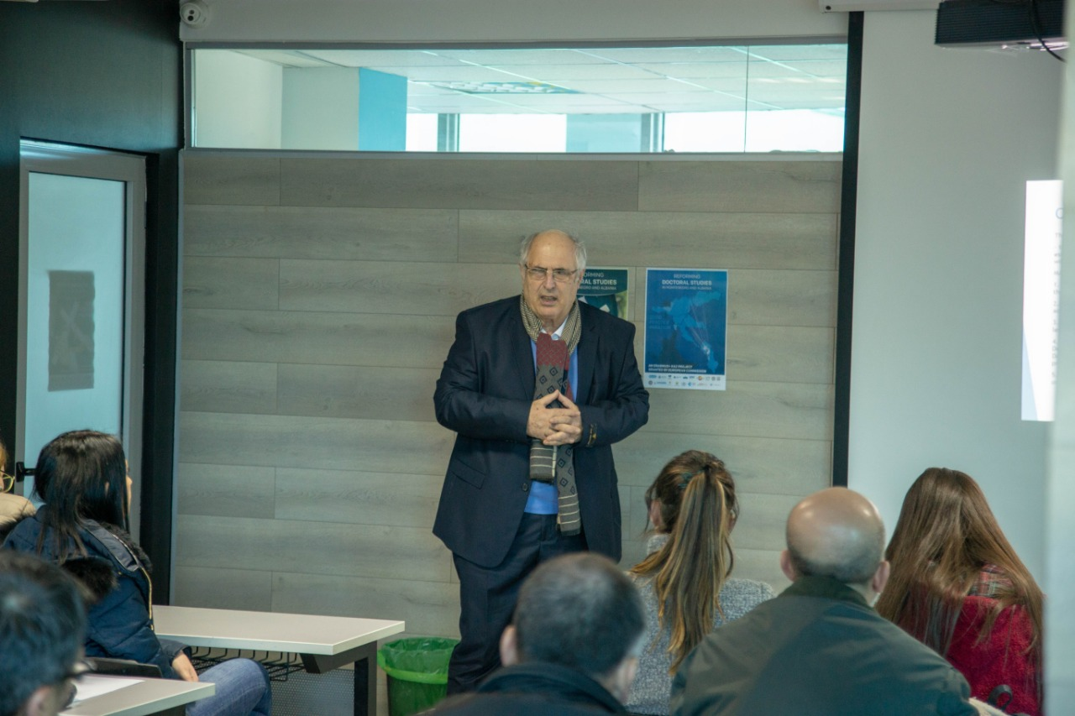
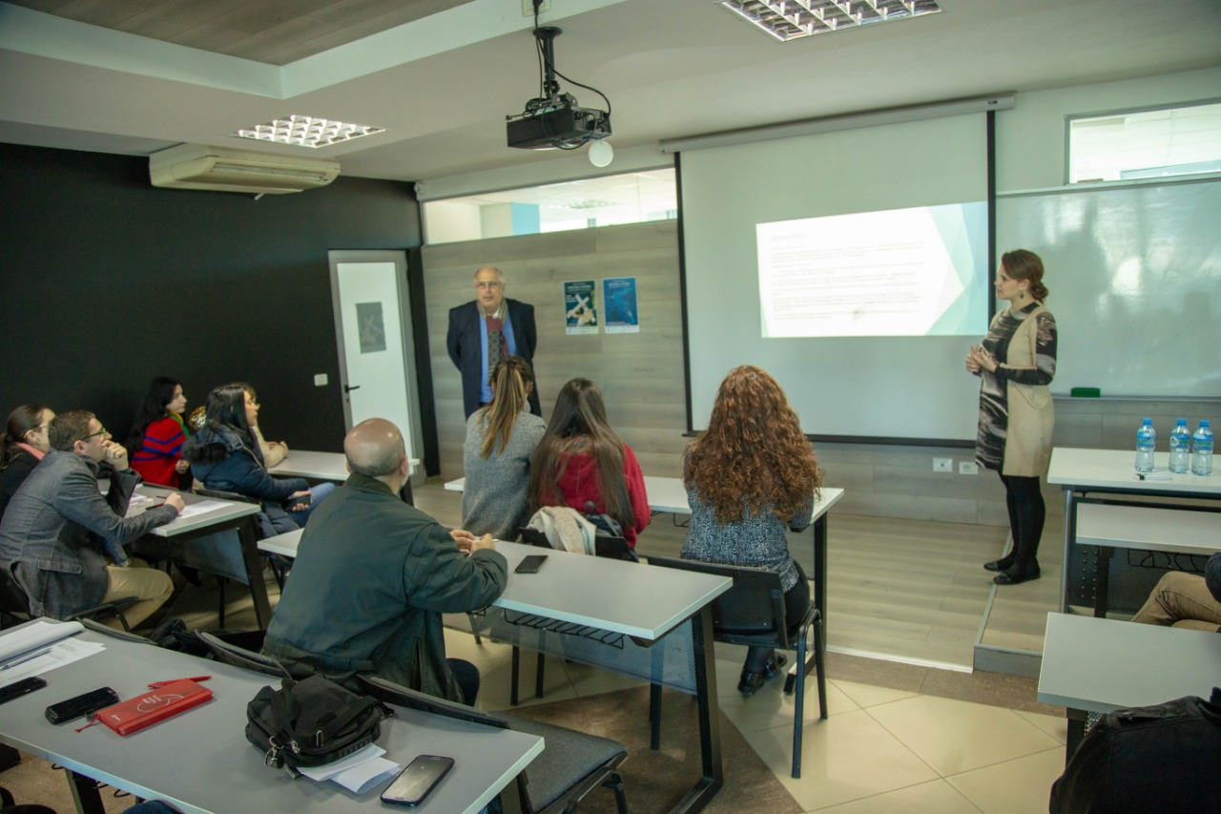
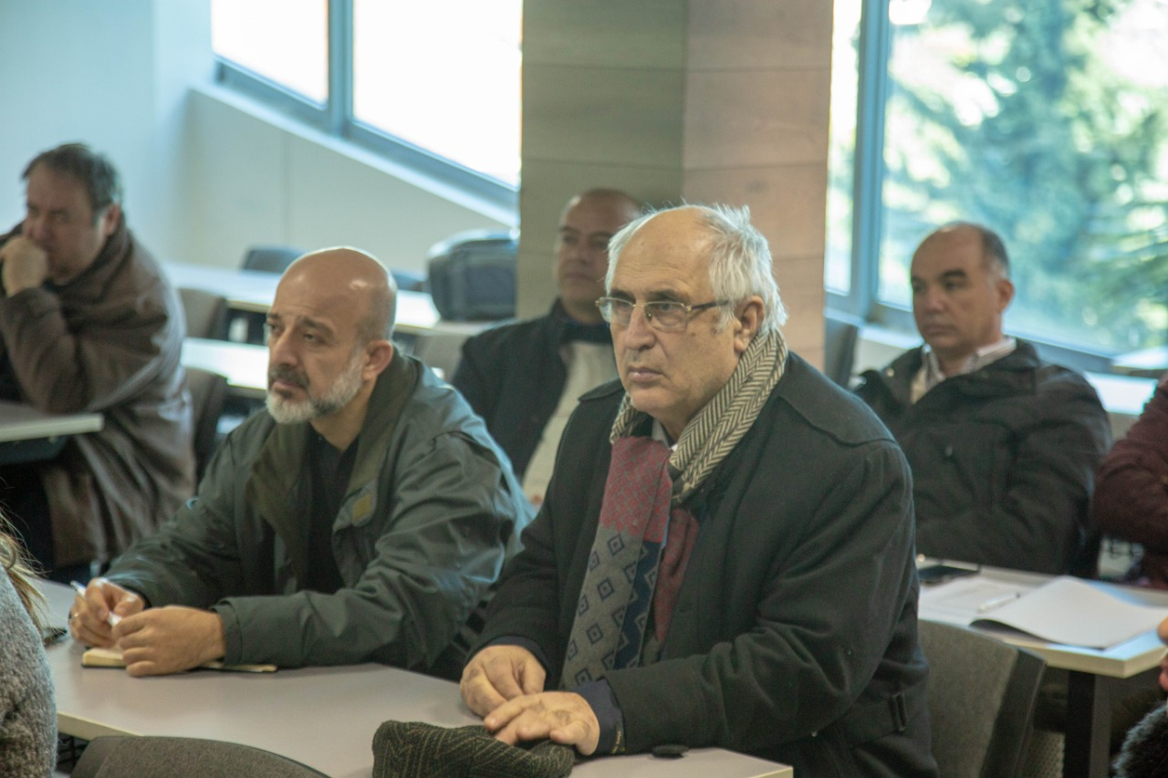
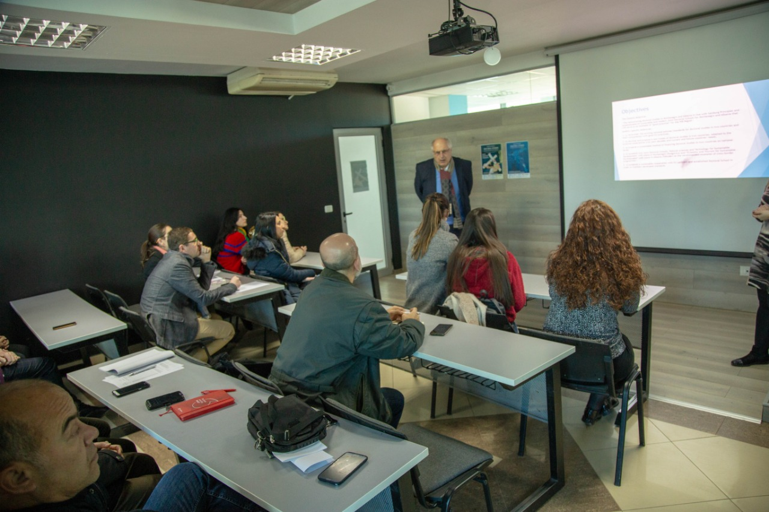
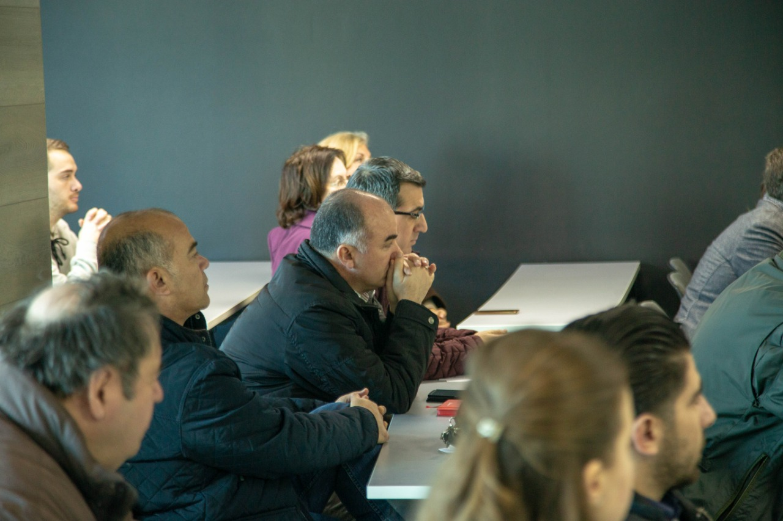
Local event for dissemination of the project

Slide 15
Thank you
Questions?

